Slide 1
API Workshop: Getting started with APIs using Python and VSCode
Rahul Damodaran
May 2022

Slide 2

Agenda
Environment setup
Packages and extensions
Python scripts

Slide 3
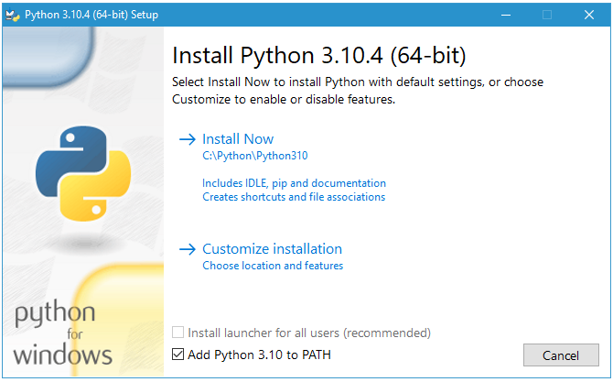
Environment Setup
Installing Python
Download & open the Python installer
Remember to check “Add Python to PATH”
Click “Install Now” for express installation
Verify installation
Open Command prompt
Type in python –version
Output: Python 3.10.4
Notes:
Alternatively, you can customize installation as well, if you prefer to change the installation folder or the components that are getting installed.
In case you miss to check “Add Python to PATH”, you will have to add it manually.
If you don’t add the location to PATH environment variable, you’ll have to include this Path in each python script that you work on.

Slide 4
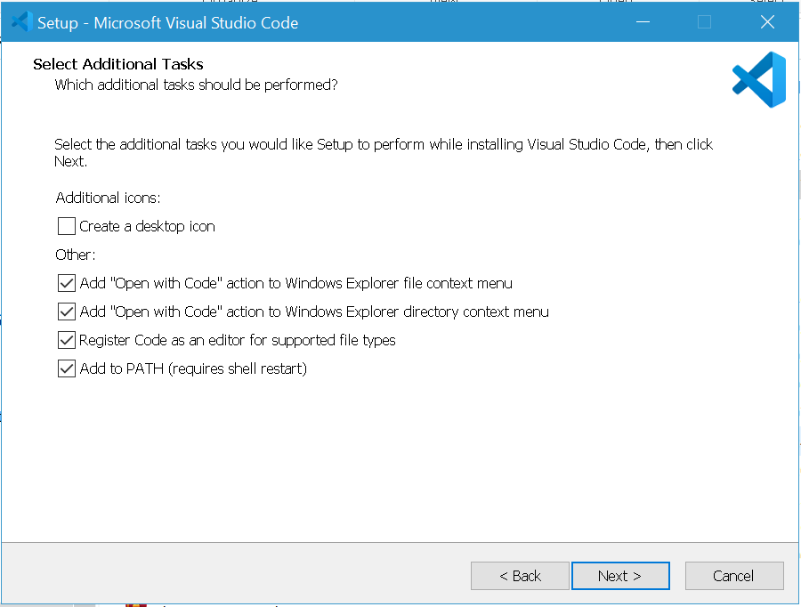
Environment Setup
Installing VSCode
Download & open the VSCode installer
Remember to check “Add Python to PATH”
Launch VSCode
Start menu
Win + R and type code
Initial configuration
Notes:
The first time you open VSCode, it will prompt you for a basic configuration related to User experience, like the theme, and components you want on your screen, integrating with GitHub. I’m just going to select the theme. We’ll configure git integration later. I’ll click “Mark done”.
By default, you see the “Get Started” tab with options to create/open files. I’ll just close it for now.
On the top, you have the VSCode Menu and on the left, you have the “Actions “bar.
The first button, for file explorer, then you have the search, followed by Source control, run and debug, and then Extensions.

Slide 5
Environment Setup
Installing GitHub Desktop
Download & open the VSCode installer
Remember to check “Add Python to PATH”
Launch VSCode
Start menu
Win + R and type code
Initial configuration
Notes:
The first time you open VSCode, it will prompt you for a basic configuration related to User experience, like the theme, and components you want on your screen, integrating with GitHub. I’m just going to select the theme. We’ll configure git integration later. I’ll click “Mark done”.
By default, you see the “Get Started” tab with options to create/open files. I’ll just close it for now.
On the top, you have the VSCode Menu and on the left, you have the “Actions “bar.
The first button, for file explorer, then you have the search, followed by Source control, run and debug, and then Extensions.

Slide 6
Packages & Extensions
Python Packages
Requests (Send api requests)
pip install requests
Json
pip install json
Pandas (Reading from an excel)
pip install pandas
Uuid (Generate unique identifiers)
Included in default packages
VSCode Extensions
GitHub
GitHub pull requests and Issues
Python

Slide 7
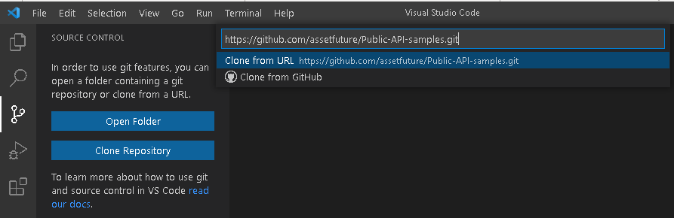
VSCode
Clone repository
Under source control
Clone Repository
Provide the repository Url
Select the repository location
Open the folder
Open Explorer from “Actions” Bar
Open folder

Slide 8
Python scripts
GitHub repository
https://github.com/assetfuture/Public-API-samples
Getting Started
Get Areas.py
Post Areas.py

Slide 9
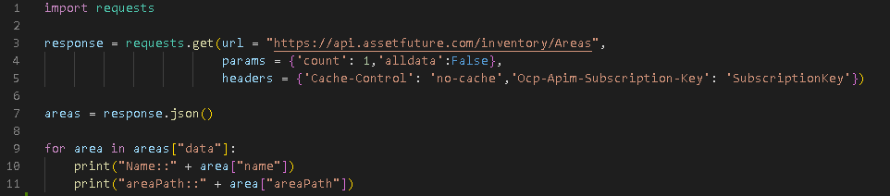
Python Scripts
Download Data using APIs
To upload data using APIs with Python script:
Install & import relevant packages (Line 1)
Prepare the API request (Lines 3-5):
Url – URL to access the API (API endpoint)
Parameters – Attributes to be included in the request
Headers – Attributes to be included as Header
Capture the response (Line 3)
Once you have captured the response, you can transform the data in any way you want. (Lines 7-11)

Slide 10
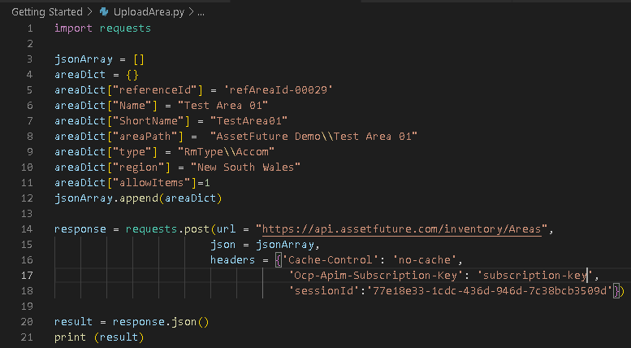
Python Scripts
Upload Data using APIs
To upload data using APIs with Python script:
Install & import relevant packages (Line 1)
Prepare API request payload (Lines 3-12)
Prepare the API post/put/patch request (Lines 15-18):
Url – URL to access the API (API endpoint)
json – request payload
Headers – Attributes to be included as Header
Capture the response (Line 20)
Once you have captured the response, you can transform the data in any way you want. (Lines 7-11)

Slide 11
Resources
AssetFuture Developer portal:
Site: https://developer.assetfuture.com/
Learning:
Python
Official site: https://www.python.org/about/gettingstarted/
VSCode
Official site: https://code.visualstudio.com/docs/introvideos/basics
Installers
Python 3.10.4
Official site - https://www.python.org/downloads/
VSCode
Official site - https://code.visualstudio.com/download

Slide 12

Thank you

